Slide 1

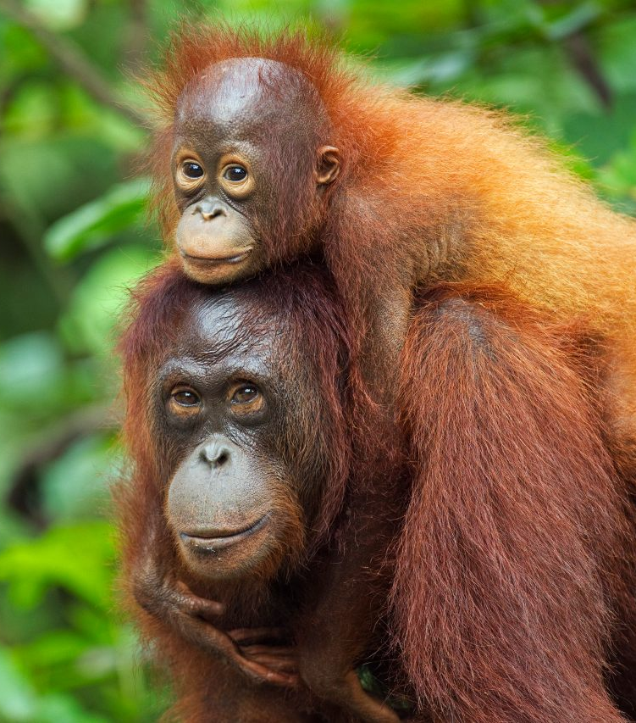


Who I am

Slide 2
Research motivations

Slide 3
Next big challenges

Slide 4
